Slide 1
Northwest Geriatrics Workforce Enhancement Center and the
Primary Care Liaison Role
ADS Advisory Council Meeting
March 14th, 2025
The NW GWEC is made possible by Grant Number U1QHP53066 from the Health Resources and Services Administration (HRSA), an operating division of the U.S. Department of Health and Human Services. Its contents are solely the responsibility of the investigators and do not necessarily represent the official views of HRSA or the U.S. Department of Health and Human Services.
Notes:
Elizabeth is talking here
Introduce yourself in the chat!
Put your questions in the chat and we’ll address them at the end where we will have a brief FAQ
- Welcome, thank everyone for being here and grounded in the 20,000 foot view

Slide 2

Land Acknowledgement
We acknowledge the Coast Salish peoples of this land, the land which touches the shared waters of all tribes and bands within the Suquamish, Tulalip and Muckleshoot nations.
Notes:
Aimee do this slide - As we gather in this virtual space, we recognize that we are connected with one another through the winds that blow air into our lungs and through the waters that move deep into the earth and up into the sky. We acknowledge that the ground beneath our feet is historically the home of Indigenous Peoples, many of whom have been forced to leave for other lands. We share now the names of the peoples who were the first to live, celebrate, lament, and sing upon the land where we now sit.
May we also remember that Indigenous Peoples are not a people of the past, but are here with us now. If there are Indigenous People on this call, you are invited to share your tribe so that we may recognize you.

Slide 3
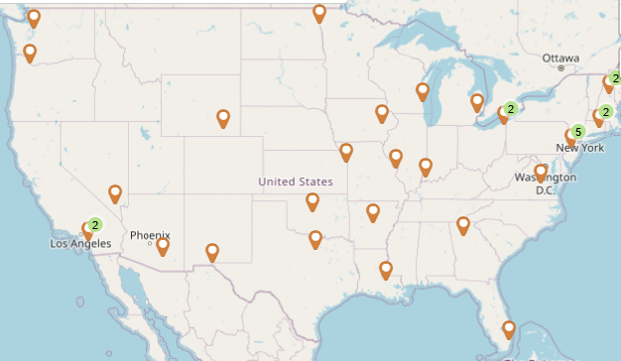
Northwest Geriatrics Workforce Enhancement Center (NW GWEC)
One of 42 centers funded through Health Resources and Services Administration’s (HRSA) Geriatrics Workforce Enhancement Program (GWEP) initiative
GWEP Goal: Educate and train the primary care and geriatrics workforces to provide age- and dementia-friendly care
Notes:
Mention how long NW GWEC or GEC has been around. 30+ years.

Slide 4

GWEP Objectives
Develop reciprocal partnerships
Provide interprofessional geriatrics clinical training & education
Focus on tribal, tribal organizations, underserved and/or rural settings
Notes:
The 3 objectives are HRSA-defined and found throughout the SWP.

Slide 5




Enduring Partners – Area Agencies on Aging

Slide 6

Executive Team Members
Elizabeth Phelan (Medicine/Gerontology)
  GWEP Project Director
Barbara Cochrane (Nursing)
  GWEP Co-Director
Katherine Bennett (Medicine/Gerontology)
  Education Director
Leigh Ann Mike (Pharmacy)
  Pharmacy Lead
Anita Souza (Nursing)
  Age-Friendly Outreach Coordinator
Aimee Verrall (Public Health)
  NW GWEC Program Manager

Slide 7

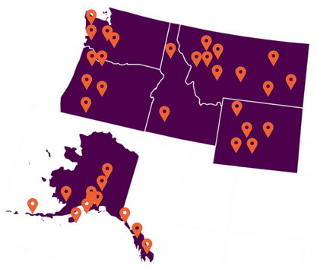


Our Regional Reach

Slide 8
Our Target Audience
Primary care workforce in Tribal, Tribal Organizations, Underserved and/or Rural locations
Supportive care workforce (patients, families, care partners, and non-medical service providers (e.g., housekeepers)
Primary Care Residents
Non-medical service providers
Older Adults
Primary Care Teams
Direct Care Workers
Families and Caregivers

Slide 9
Origins of the
Primary Care Liaison (PCL)
Notes:
Elizabeth to start speaking here

Slide 10
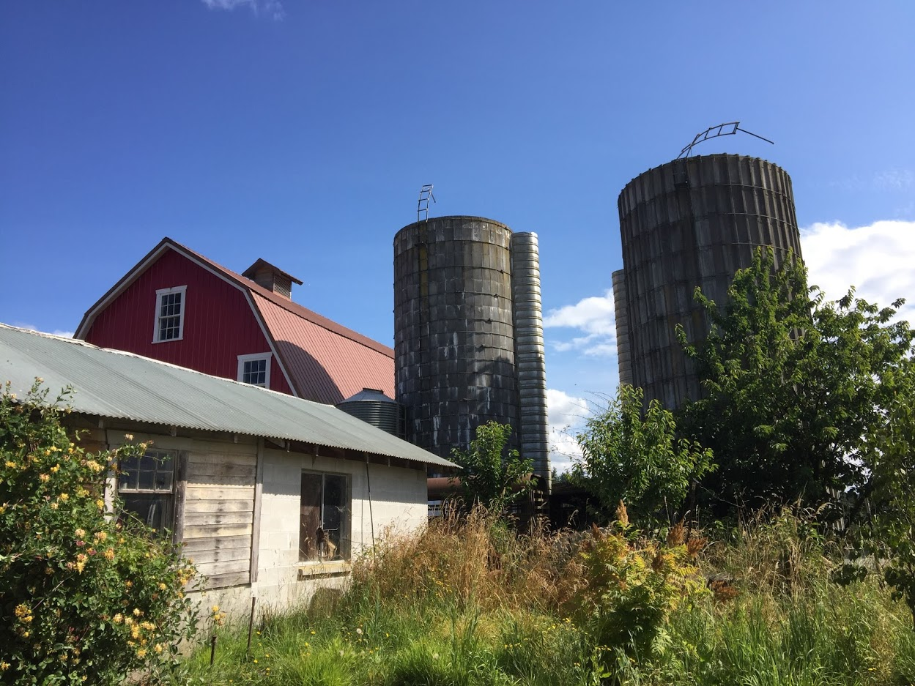
The Problem: “Silo-ing” of Care
Older adults, care partners and clinicians unaware of community resources
Community agency services and evidence-based programs undersubscribed
Huntingford’s farm, Chimacum, WA
Notes:
Elizabeth – Primary Care Liaison – the Model, Concept, and Development
Broadly: there is a silo-ing of care, meaning that there is no "cross-talk" btwn different settings where older adults receive care. A systematic review by Porterfield et al (2012, full cite above) found few examples of clinical practice-community organization partnerships. This situation fosters a mutual lack of awareness on the part of each silo of what happens in the other.
We can even go so far as to say that, in the case of primary care, there is low awareness that other silos relevant to their work even exist! A quote from a physician training in geriatric medicine illustrates this point: “I'd never heard the term “Aging Network" -- nor did I have any insight into what that network could offer. The result is a missed opportunity to improve population health via interactive partnering around care delivery.”
Primary care providers typically also have no idea if their patient has a case manager in the community, who that person is, and what the implications of it are (why the patient qualified for case management, who the case manager is and how to contact that person, what they do and how they could facilitate care for that patient)
The lack of community-clinic connections also likely affects providers. Care of complex patients is challenging and can make providers feel overwhelmed and alone (low provider satisfaction, low numbe.rs choosing primary care, burnout and leaving primary care)
- Tendency for health professionals to "do for" rather than "enable" patients and their families also promotes a tendency toward burnout

Slide 11

The Idea: Building Community-Clinic Bridges
Suspension bridge in Mount Rainier
Increase awareness
Encourage referrals to community-based programming
Encourage and facilitate bi-directional communication
Notes:
Elizabeth
Opportunity! Enhance Community-Clinical Linkages through ACTIVE BRIDGING BTWN COMMUNITY AND PRIMARY CARE
- Increase primary care workforce awareness of community agency roles and functions in the care of older adults (through focused training about the Aging Network and community resources (esp evidence-based, health promotion programs) serving older adults and their care partners, -- done on-site, in the community, by the community agency itself -- targeting those most likely to use the information and who have insights into the care of their patients)
- Encourage referrals of patients to relevant c-b programs (via active and ongoing outreach by the Primary Care Liaison to primary care medical home clinics)
- Encourage and facilitate bidirectional communication around treatment planning and execution, and monitoring
-Timing is “right” for this, given the new emphasis on reimbursing for quality and outcomes instead of episodes of care (i.e., ACOs and “value-based purchasing”)

Slide 12
PCL Approach
Employed by an Area Agency on Aging
Establishes community-clinical linkages through engaging healthcare teams
Facilitates referrals to AAA programs and services
Increases enrollment into evidence-based health promotion programs
Notes:
Elizabeth
Getting Started (or, thinking about how to integrate this into one's own work setting): What does this look like in practical terms?
PCL embedded in AAAs – the AAA Is the hub of the local aging network, so it makes sense to house a PCL there. The PCL would be an expert on local AAA resources and also have relationships with AAA program staff. The PCL should have the following skills - educator, good communicator/connector, and strong grasp of local community resources, at a minimum)
Creating linkages – in-person outreach to multiple practices, raising awareness of AAA resources, promoting evidence-based programs
Simple process for primary care to make a referral of a patient and/or their care partner to the AAA
Enrollment of care partners and patients into evidence-based programs
Better care - e.g., increased delivery of preventive services, geriatric syndrome screening and management)
Better health outcomes (e.g., improved health behaviors, healthier caregivers)
Better quality of life
Fewer care transitions
Fewer readmissions
Fewer (preventable) ED visits and hospitalizations
Higher provider (PCP, agency staff) satisfaction

Slide 13
Results of our Feasibility Study
Am J Prev Med 2021;61(6):e305−e312.

Slide 14
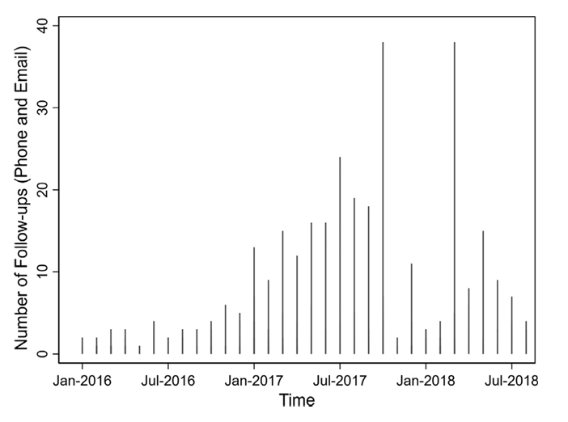
PCL Outreach
Notes:
This figure illustrates how follow-up contacts (phone calls and e-mails) between primary care and the PCL increased over time (across 2 Area Agencies on Aging).

Slide 15
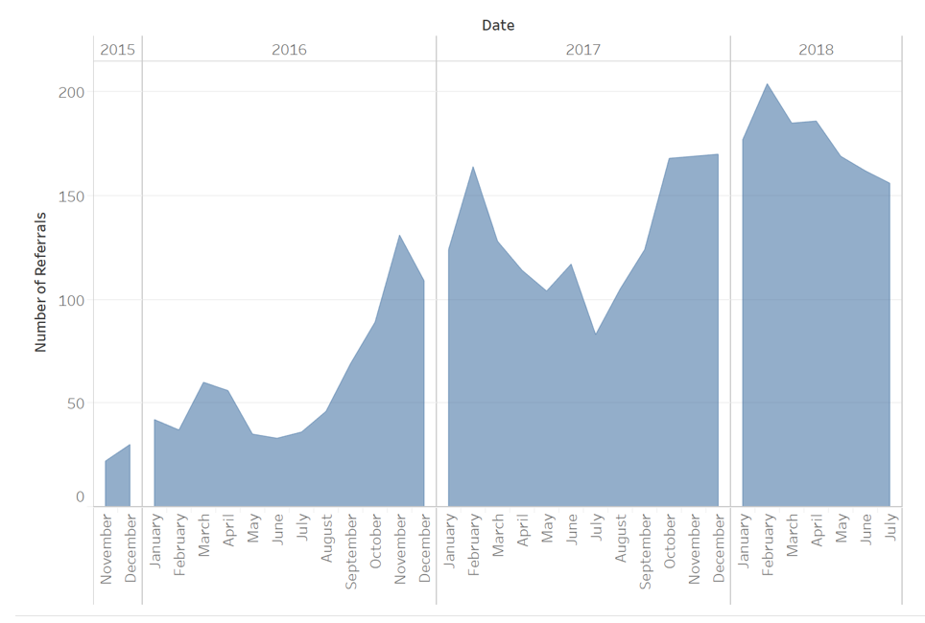
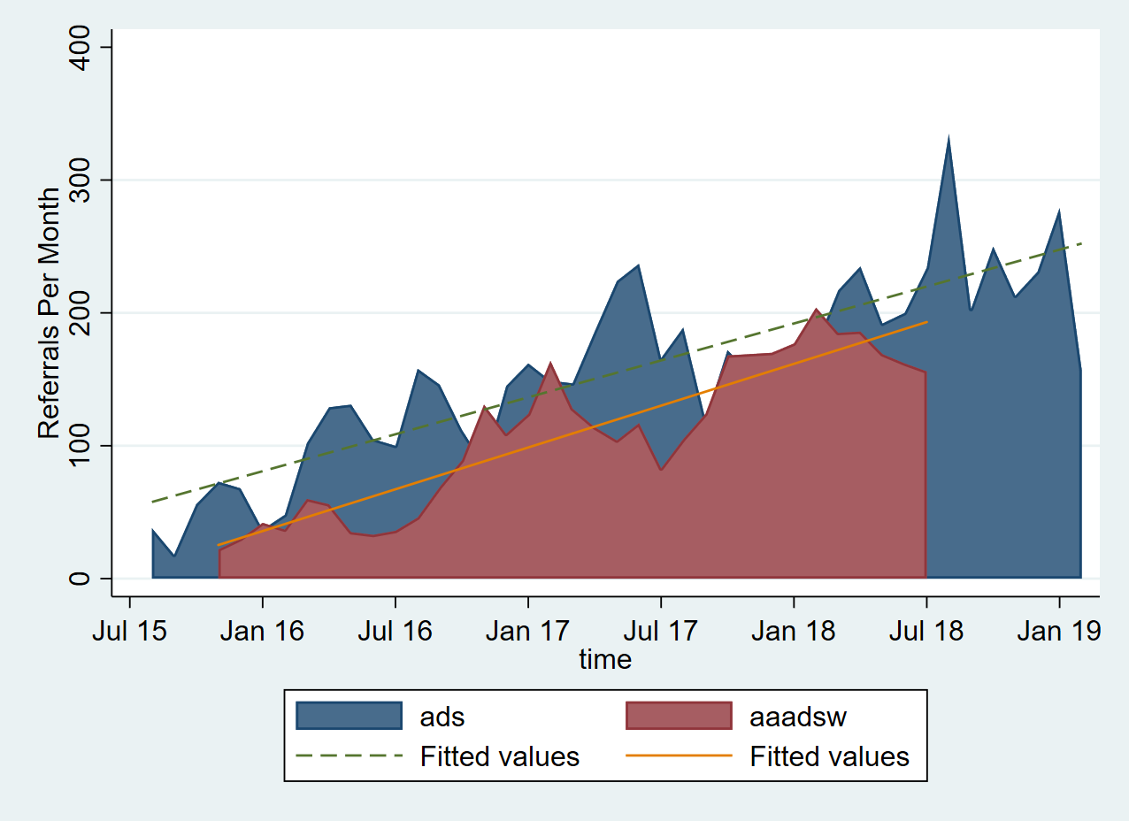
Outcomes: PCL Driven Referrals
Over 3,000 referrals, averaging 109 referrals / mo
Notes:
Elizabeth
This figure shows that, subsequent to the PCL position being established, referrals from primary care to the AAAs increased over time, at both area agencies on aging. ADS is shown in blue and AAADSW in red.

Slide 16
ADS Perspective on the Primary Care Liaison

Slide 17
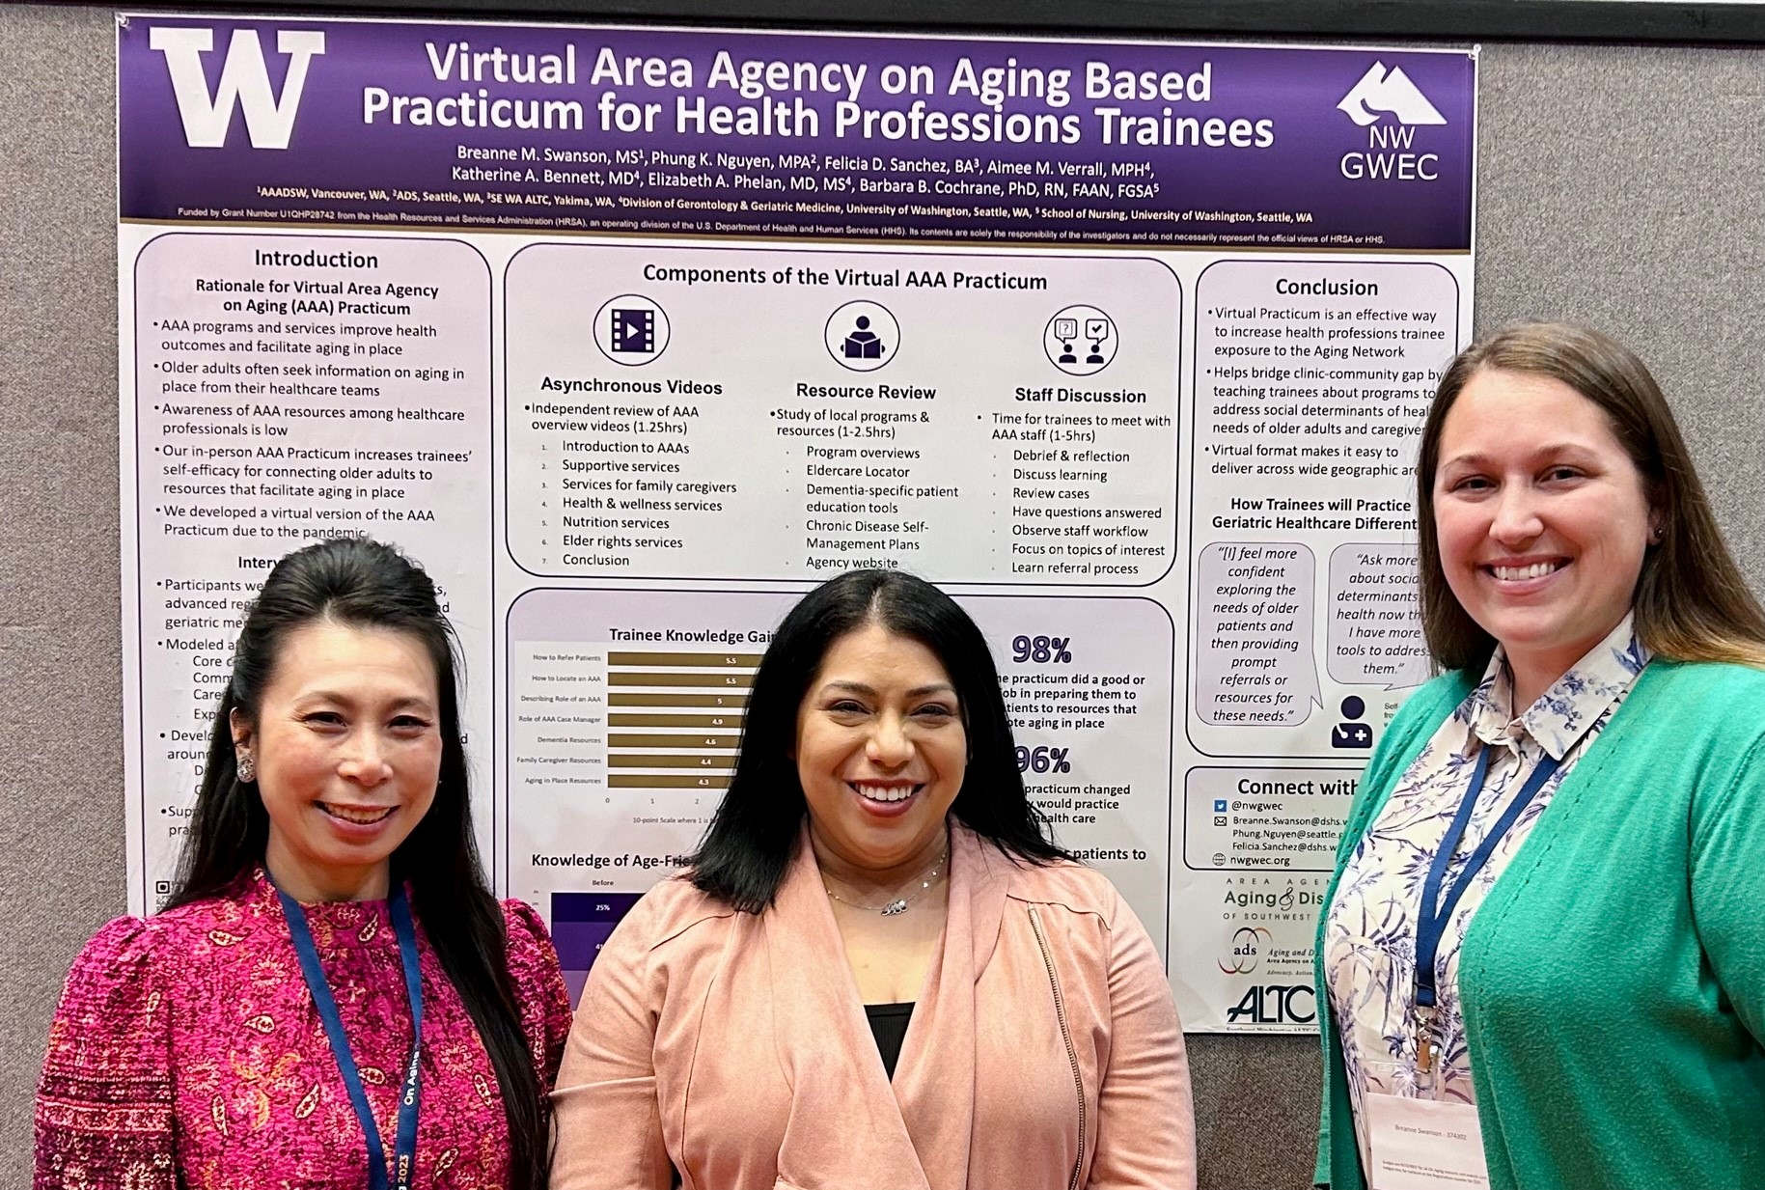
Why a Primary Care Liaison Role at an AAA?
Build sustained linkages with clinics and health systems
Increase visibility and credibility of AAAs (AAAs become seen as part and parcel of primary care)
Encourage and facilitate ongoing communication
Increase awareness of AAA resources and facilitate their integration into an individual’s primary care
Notes:
Phung – PCL in Practice / ADS Perspective
Other goals synergize with our AAA’s
As the Area Agency on Aging, our goal is to increase awareness, referrals and visibility of aging services to everyone in our community.
The PCL role is important because it has allowed ADS to meet our goals by expanding our outreach strategies and collaboration with clinics and local healthcare systems.
By creating these linkages, we can better support older client’s needs by making it easier for them to navigate our complex system and access to many of our services.

Slide 18
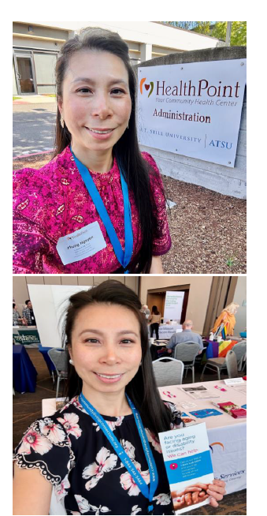
ADS Success Story: Outreach during COVID-19
Meeting clinical contacts where they are at (virtual vs in-person).
Successful connection with a Community Resource Specialist from Kaiser Northgate Clinic during a virtual meeting hosted by our Community Living Connections network of providers, including healthcare teams.
This Community Resource Specialist (champion) opened doors that forged connections with all King County Kaiser clinics.
Notes:
Phung – Update to a current example? I love these photos of you outreaching – these are great!
During COVID-19 pandemic it dramatically changed people’s priorities and needs. Clinics and hospitals were concerned about healthcare providers fatigue and staff capacity. So this created new opportunities to partner with them and share information, including COVID-19 resources.
In response to the pandemic, I relied on reaching out to healthcare practices by telephone and electronic mail instead of the initial in-person drop-in clinic visits.
One of the challenges with e-mail/phone outreach was identifying a contact for new clinics or clinics with staff turnover.
The challenges of navigating the phone system, long wait time, and dropped calls weren’t fun. Some clinics and healthcare call centers were unable to share specific contact or they were not responsive.
And to overcome these challenges, one of the strategies that I used was to connect with existing network to initiate an introduction followed by an e-mail connection to the clinics. For example, I was able to connect with a Community Resource Specialist from Kaiser Northgate Clinic during a virtual meeting very quickly by sending her a private message in the chat box. This meeting was hosted by our Community Living Connections network of providers.
And I was super excited to see a staff from Kaiser because this was one of the clinic systems that I tried to connect before the pandemic. She was a clinic champion who was very opened to connecting me with her supervisor so we could proceed with scheduling a virtual meeting for all of Kaiser clinics to learn more about aging services and how to navigate referral process.

Slide 19
ADS Success Story: The Power of Existing Relationships
Working with a known network of geriatrics champions (a former Swedish geriatric medicine fellow) who is now the Specialty Director of Geriatrics at HealthPoint in Redmond.
We were able to meet quickly due to our partnership with NW GWEC. I was excited to be a part of the clinic’s goal of developing ready access to the PCL’s recorded Aging Programs & Services presentation available in a cloud-based location for others across HealthPoint (14 clinic locations).
HealthPoint clinic reported, “[Your presentation] was so informative. I already have patients I will be referring using the online form.”
Notes:
Phung – Update to a current example? I love these photos of you outreaching – these are great!
Since COVID-19 pandemic virtual outreach visits have efficiently allowed me to meet and share information with multiple clinics across a healthcare system in a single virtual space at the same time. Video conference meetings also allowed flexibility for care teams to participate from their office space.
Using existing relationship with NWGWEC network of geriatrics, I was able to connect quickly and set up a virtual meeting with a former Swedish geriatric medicine fellow who is now working at HealthPoint clinic in Redmond.
I was especially excited to be a part of the clinic’s goal in developing ready access to my recorded presentation of aging services that will be available in a cloud-based location for others across 14 HealthPoint clinic locations.
After the meeting they’ve shared, “[Your presentation] was so informative. I already have patients I will be referring using the online form.”

Slide 20
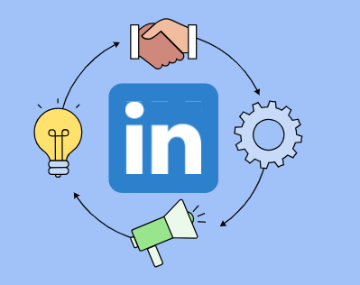
ADS Success Story: Leveraging Social Media to Maintain Connections
Working existing relationships in the Aging Network - Asian Counseling & Referral Services (ACRS) connections (daughter is a nurse).
PCL’s connection with a nurse who started at one clinic (HealthPoint), but moved to another clinic (ICHS) which restarted a connection that had dried up due to staff turn-over.
Demonstrating the importance of maintaining relationships with one champion and leveraging social media (LinkedIn).
Notes:
Phung
Working existing relationships in our Aging Network, I connected with a staff from the Asian Counseling & Referral Services (ACRS). She was excited to learn about the PCL role and wanted to introduce me to her daughter who was a nurse at HealthPoint clinic in south King County.
My connection with a nurse started at one HealthPoint clinic, but later moved to another clinic at ICHS which restarted a connection that had dried up due to staff turn-over.
This example demonstrated the importance of maintaining relationships with one clinic champion and leveraging social media (LinkedIn) to stay connected.

Slide 21
Phung’s Approach to Outreach
Identify all healthcare systems in King County
Create list of clinics for outreach
Intro letter and info packet
Use existing relationships to connect with clinics
Drop-in clinic visits for follow-up contact
Ask an established clinic to connect with other clinics
Fellows/RN trainees make intro to their clinics
Connect with healthcare providers at resource fairs
Email/call to schedule team meetings
Respond to requests for info and mail out brochures
Notes:
Phung – use slides to talk

Slide 22
Implementation Guide
Notes:
Elizabeth to introduce the Guide

Slide 23
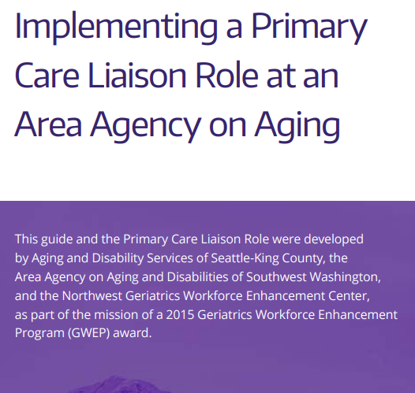
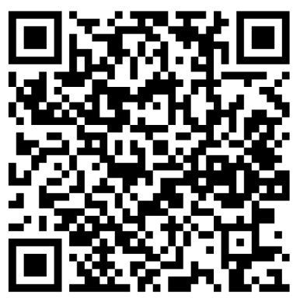
Download Guide:
Notes:
PCL Toolkit focus here

Slide 24
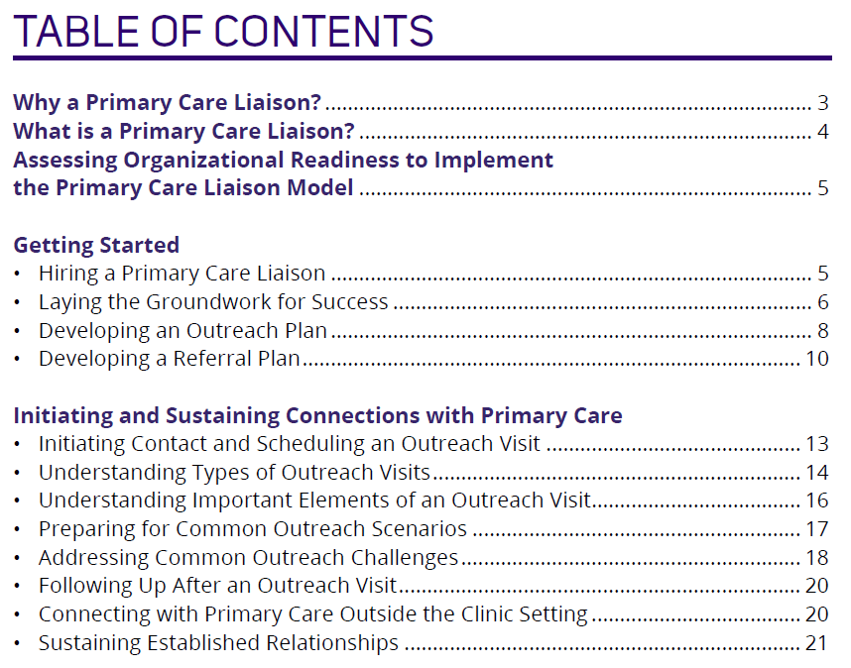
Topics Covered
Notes:
Screen shot the TOC

Slide 25
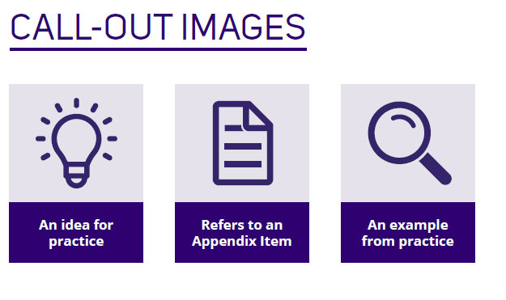
Valuable Examples and Ideas
Notes:
may give examples of each verbally.

Slide 26
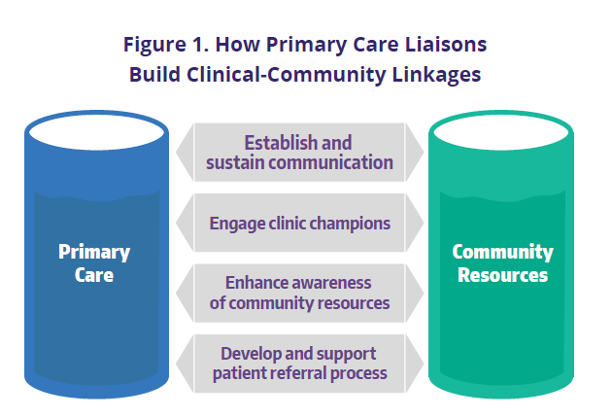
What is a Primary Care Liaison?
Notes:
Phung
A Primary Care Liaison is a point of contact for primary care clinics and other healthcare teams to connect patients, families and their caregivers to community-based programs.
The PCL is also a connector and a resource for care teams across multiple healthcare systems such as Multicare, Virginia Mason Franciscan Health, and Valley Medical clinics.
By engaging and maintaining communication with clinic champions, the PCL can share information and disseminate program materials to their care teams.
Also, the PCL can help them better understand how to navigate the AAA referral system and processes within our aging network.
This makes it easier for clinics to send referrals and how to troubleshoot issues as they come up.

Slide 27
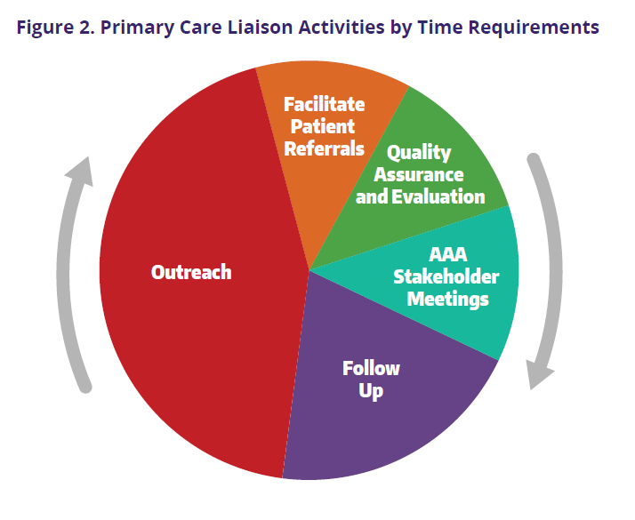
What Does a Primary Care Liaison Do?
Outreach:
One-on-one meetings
Team meetings or huddles
Drop-in and Drop-off visits
Visits with trainees
Virtual Visits
Notes:
Phung to show how her real-live outreach experiences are incorporated into the Toolkit
A majority of the time is focused on outreach activities and follow up with clinics.
This included driving across the county to drop-off program materials or drop-in the clinics and speak with the front desk staff or a clinic manager.
Other times it would be mailing program brochures especially during the pandemic
Once a connection is established, I scheduled team meetings (either in-person, virtual or hybrid) to share more information about our programs /services and answer questions (e.g. program eligibility, immigration status, how to send in referrals, etc.)
The PCL role also expanded outreach to support our Care Transitions program to reduce emergency hospital admission rates by helping patients with care coordination services and connecting them to community resources.

Slide 28
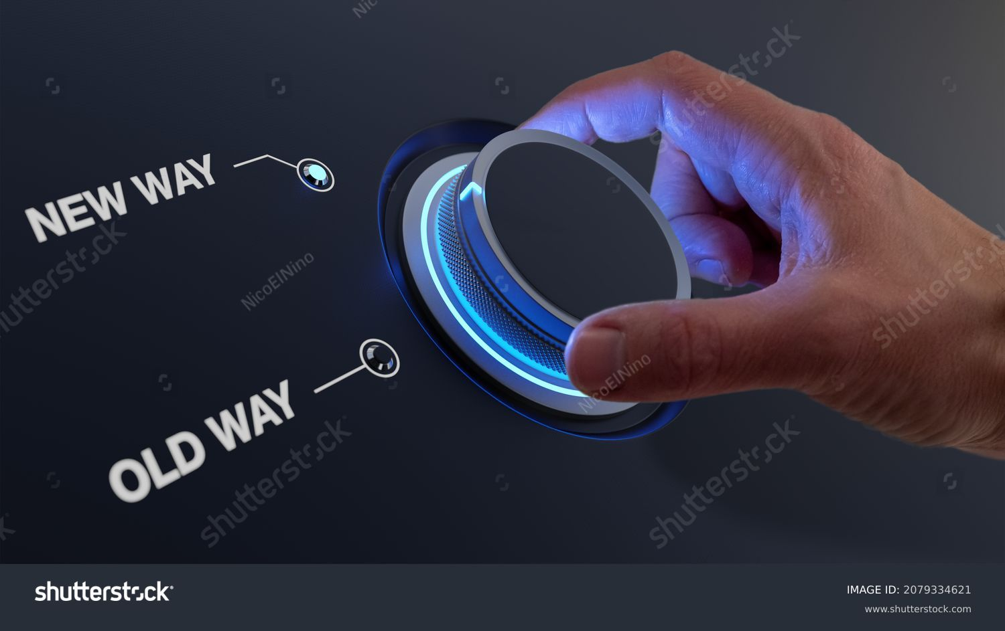
Organizational Readiness
Organizational support
Adequate funding
Organizational commitment
Technical assistance
Capacity for increased referrals
Long-term sustainability
Notes:
Elizabeth picking it back up here

Slide 29

Getting Started – Hiring a Primary Care Liaison
Outstanding verbal and written communication skills (messaging)
Outstanding interpersonal skills (rapport and connections)
Experience with outreach and engagement
In-depth knowledge of the AAA and Aging Network

Slide 30
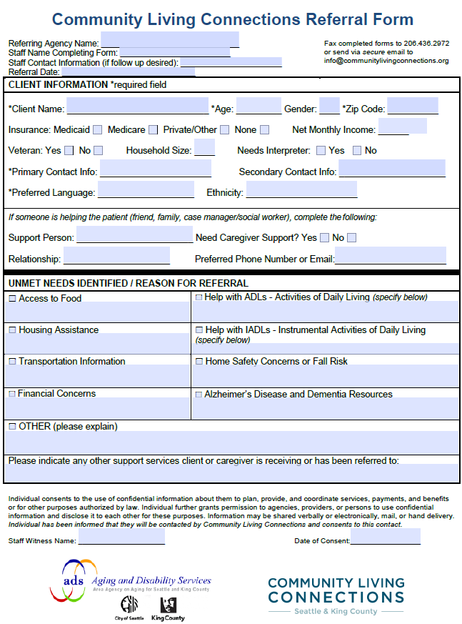
Developing a Referral Process
Notes:
Describe different processes ADS networked approach vs paper forms at other AAAs

Slide 31
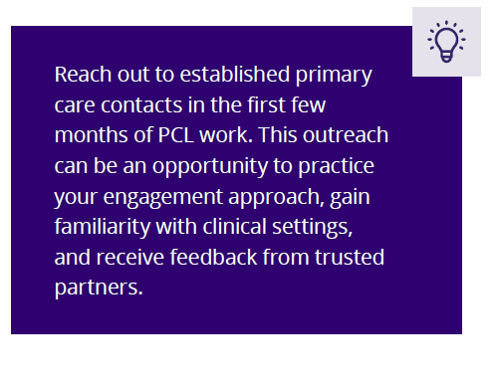
Strategies for Success / Developing a Plan
Inventory and catalog AAA resources
Understand marketing the AAA
Compile a list of practices
Target engagement
Tailor outreach to the needs of the clinical setting

Slide 32
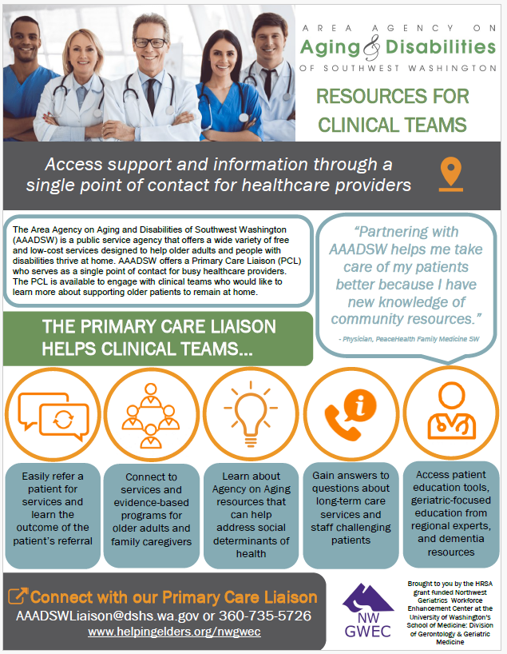
Example Outreach Flyer for Primary Care Providers

Slide 33
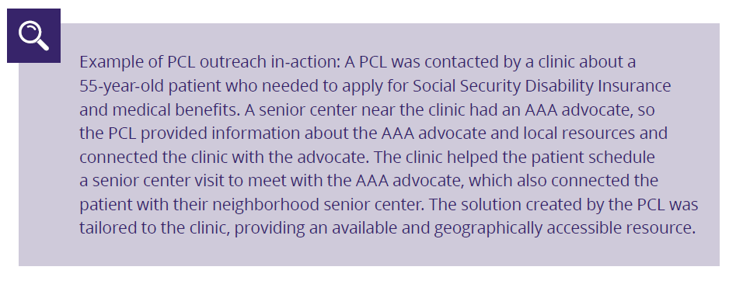
Real-Life Outreach Examples

Slide 34

Overcoming Outreach Challenges
Initiating contact
No response
No existing contact
Staff turnover
Combating “sales” tactics”
Understanding critical shortages and burnout

Slide 35

Sustaining Established Relationships
Strive for periodic, meaningful communications
Assist clinic staff with getting answers to any questions
Offer to staff challenging patient cases
Arrange ongoing check-ins
Notes:
Outreach examples

Slide 36
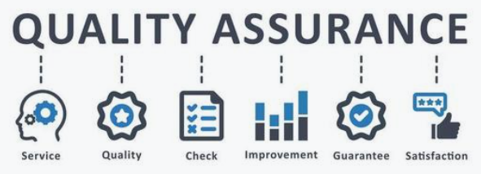
Quality Assurance and Evaluation
Evaluate program delivery to ensure that effective, high-quality services are delivered and program goals are met
How to track outreach data
How to evaluate

Slide 37

How can we further spread the word about the PCL model and the implementation guide?
Efforts thus far:
  Meeting with Cathy Knight to discuss dissemination strategies
    Cathy shared with ~12 AAA directors from across the US in a Director’s Meeting
  Presentations to W4A audiences by PCLs
  PCL-led workshop accepted for 2025 USAging conference
Notes:
Elizabeth to cover this slide and solicit ideas

Slide 38

Question and Answer Period

Slide 39
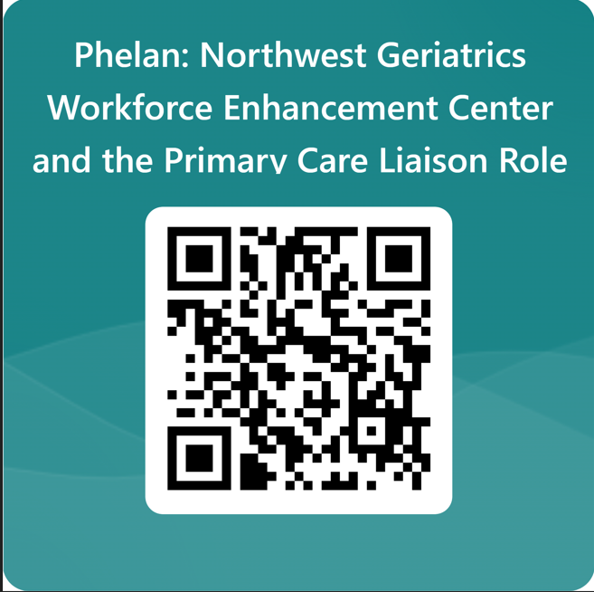
Evaluation Slide

Slide 40

Ongoing Benefits to the Area Agency on Aging
PCL as a source of momentum
Increased healthcare and CBO interest in new partnerships and enhancing existing collaborative efforts
Increased geriatric competency of professionals at the AAA and in the Aging Network
Decreased isolation of agency staff
Notes:
Phung -
Having a dedicated PCL that works directly with healthcare organizations enhances existing collaborations and allows us to build new partnerships. These contacts produce substantial increases in referrals as providers are motivated to refer patients to us. Therefore, the PCL is seen as a source of momentum at the AAA as the work they conduct helps generate many new referrals.
Thanks to the PCL’s efforts, providers are increasingly aware of services for older adults, they better understand their patient’s needs, and they have a broader range of skills. All of these things increase the geriatric competency of healthcare professionals in the Aging Network.
The PCL also decreases isolation of agency staff as they now have healthcare partners who understand their role and how they help patients. Agency staff no longer feel like they are working alone to help their clients.

