Slide 1
Novel
Coronavirus
Public Health – Seattle & King County
February 14, 2020
Ingrid Ulrey
Policy Director
Ingrid.ulrey@kingcounty.gov

Slide 2
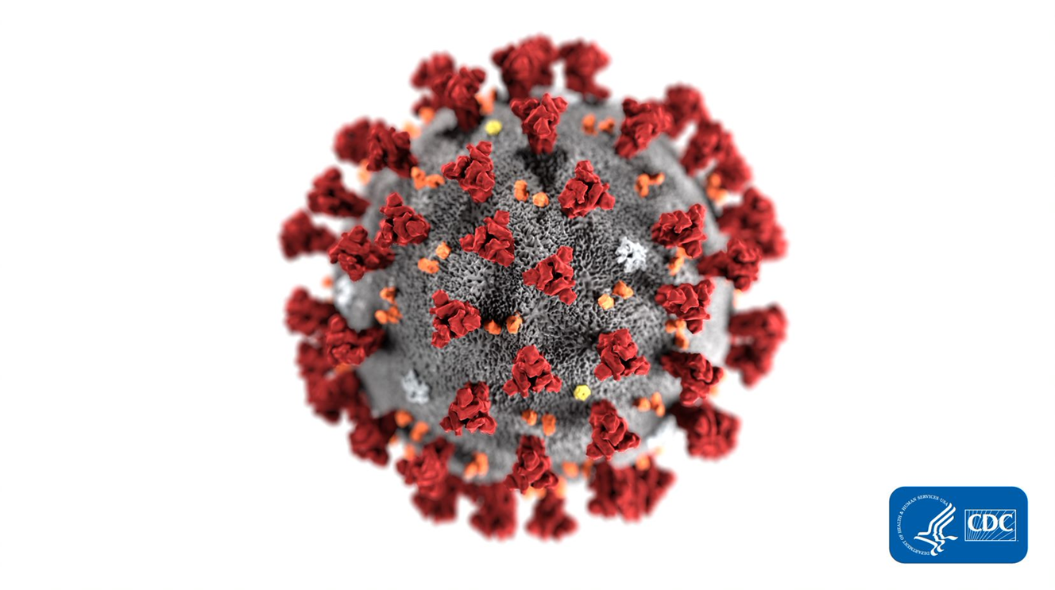
What is novel coronavirus (2019-nCov)?
Notes:
Coronaviruses are a large family of viruses, which usually cause mild respiratory illness such as the common cold. (MERS and SARS are also in this family)
Novel coronavirus (2019-nCoV) emerged in Wuhan, China in December 2019.
This virus had not been seen in humans before.
There are a growing number of cases confirmed internationally and in the U.S., including one case in WA state on January 21, 2020.
The virus has the potential to cause severe illness and pneumonia in some people.
Globally, WHO has declared nCoV to be a Global Health Emergency of International Concern and the U.S. federal government declared the situation to be a Public Health Emergency. Locally, Public Health has activated its Health and Medical Area Command to respond.
We consider this outbreak to be a very serious public health threat, but it is important to understand that based on current information, novel coronoavirus is not spreading in the community anywhere in the US and the health risk to the general public in the US and in King County is low at this time.

Slide 3
How does novel coronavirus spread?
Coughing or
sneezing
Close personal
contact
Touching an object
or surface
Fecal contamination
Notes:
Other coronaviruses that infect humans spread from someone who is ill primarily by close person-to-person contact, most readily by respiratory droplets produced when the infected person coughs or sneezes.
It can also likely be spread by:
close personal contact, such as touching or shaking hands
touching an object or surface with the virus on it, then touching your mouth, nose, or eyes
in rare cases, contact with feces
It’s fair to say this infection is able to spread from person to person, however exactly how it spreads and how readily it spreads are not known.
There has been very limited person to person transmission in the U.S., and no person to person transmission in King County at this time.

Slide 4
What are the symptoms?
People who have been diagnosed with novel coronavirus have reported symptoms that may appear in as few as 2 days or as long as 14 days after exposure to the virus.
Notes:
People who have been diagnosed with novel coronavirus have reported symptoms that may appear in as few as 2 days or as long as 14 days after exposure to the virus
These symptoms include:
Fever
Coughing
Difficulty breathing / shortness of breath
If you have returned from travel China in the past 14 days and have symptoms, contact a health care provider. Your healthcare professional will evaluate you to determine if you should be tested for 2019-nCoV.
If you have been notified by public health authorities that you might have been exposed, please follow instructions provided by your local health department or Washington State Department of Health.

Slide 5
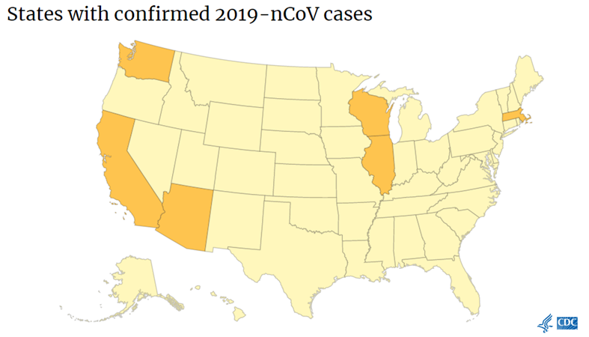
What is the risk?
Currently, risk in the U.S. is low.
13 reported cases in the U.S. as of 2/11
Very little person-to-person spread
No reported cases in King County
Most people have mild illness.
2% of people who get sick die (in comparison with 9.6% with SARS)
Notes:
At this time, the risk to the general public locally is considered to be low, given that there is only one case identified in Washington, and no cases in King County.
Person-to-person spread of 2019-nCoV has been seen among close contacts of returned travelers from Wuhan, but at this time, this virus is NOT currently spreading in the community in the United States.
Reported cases have ranged from mild illness similar to a common cold to severe pneumonia.
Deaths have been reported primarily in older adults with underlying health conditions.
For perspective, it is useful to remember that in bad flu season in King County we can see several hundred thousand flu cases and hospitalizations and hundreds of flu deaths. Each year influenza infects 10s of millions of Americans and causes 10s of thousands of deaths.

Slide 6
Steps to reduce risk of spread
Wash hands
Avoid touching
mouth, eyes, nose
Cover your mouth/nose
Stay home when
you are sick
Avoid contact with people who are sick
Notes:
Currently, there are no specific antiviral drugs or vaccines available to treat and protect against 2019 novel coronavirus infection.
You may be able to reduce the risk of spread of coronaviruses by taking the same steps as you would to prevent infection from the flu and the common cold:
Wash your hands often with soap and water for at least 20 seconds.
Use an alcohol-based hand sanitizer if soap and water are not available.
Avoid touching your eyes, nose, or mouth with unwashed hands
Cover your mouth and nose with a tissue when you cough or sneeze, then throw the tissue in the trash and wash your hands
Stay home while you are sick and avoid close contact with others
Avoid contact with people who are sick
If you are traveling overseas, especially to China, follow the CDC’s Travelers’ Health guidance: https://wwwnc.cdc.gov/travel/
Public Health does not currently recommend that people wear masks when they are in public. This is because the immediate health risk to the general public in Washington is currently low.
Additionally, scientists are not sure whether wearing a mask in public actually keeps healthy people from getting sick. It’s most important for people who are sick to wear a mask in a healthcare setting (such as a waiting room) to avoid exposing other people when they cough or sneeze.

Slide 7
Who should seek medical evaluation?
Those who are ill with a fever, cough, or difficulty breathing AND:
Have traveled from China in the last 14 days
OR
Have been identified by Public Health as a recent close contact of a confirmed 2019-nCoV case or had recent close contact with someone who is being evaluated for 2019-nCoV infection.
Notes:
Seek medical care promptly if you feel sick with fever, cough, or difficulty breathing AND have traveled from China in the 14 days before your illness onset
You should also seek medical care if you have these symptoms and have been identified as a recent close contact of a confirmed novel coronavirus case or had recent close contact with someone who is being evaluated for novel coronavirus infection
Before you go to a doctor’s office or emergency room, call ahead and tell them about your recent travel and your symptoms. They will give you instructions about how to get care quickly while preventing exposure to others. Your healthcare provider will evaluate you to determine whether you should be tested for novel coronavirus.

Slide 8
Federal government quarantine measures
On January 31, 2020, the U.S. federal government announced that they have declared the situation with novel coronavirus to be a Public Health Emergency, including instating new travel and quarantine measures.
Notes:
On Jan 31st, the U.S. federal government announced that they have declared the situation with novel coronavirus to be a Public Health Emergency.
While government officials stress that the risk to the general U.S. public continues to be low due to the small number of cases in the United States, they are taking steps to try to keep the risk low.
The federal government announced that certain passengers returning from Hubei Province and other parts of China will need to be quarantined for up to 14 days.
All flights from China will be funneled through 1 of 11 airports, including Sea-Tac International Airport.
The airports to which all flights from China will be funneled are: SeaTac International Airport (SEA), John F. Kennedy (JFK), Chicago O’Hare (ORD), San Francisco (SFO), Daniel K. Inouye (HNL), Los Angeles (LAX), Hartsfield-Jackson Atlanta (ATL), and Washington Dulles (IAD) Dallas Fort Worth (DFW), Detroit International (DTW), and Newark Liberty Airport (EWR).
Passengers returning to the United States who have been in the rest of mainland China within the previous 14 days will have a health screening by the CDC at eleven designated airports. They will be allowed to continue on to their final destination if they do not have any symptoms of illness. They will undergo up to 14 days of self-quarantine to ensure they have not contracted the virus.
Additionally, the President has signed a presidential proclamation temporarily suspending the entry into the United States of foreign nationals who pose a risk of transmitting the 2019 novel coronavirus. Foreign nationals, other than immediate family of U.S. citizens and permanent residents, who have traveled in China within the last 14 days will be denied entry into the United States at this time.
For details about passenger screening and what travelers from China should expect, see the Department of Homeland Security’s news release.
In terms of travel:
CDC recommends that travelers avoid all nonessential travel to China. In response to an outbreak of respiratory illness, Chinese officials have closed transport within and out of Wuhan and other cities in Hubei province, including buses, subways, trains, and the international airport. Additional restrictions and cancellations of events may occur.

Slide 9
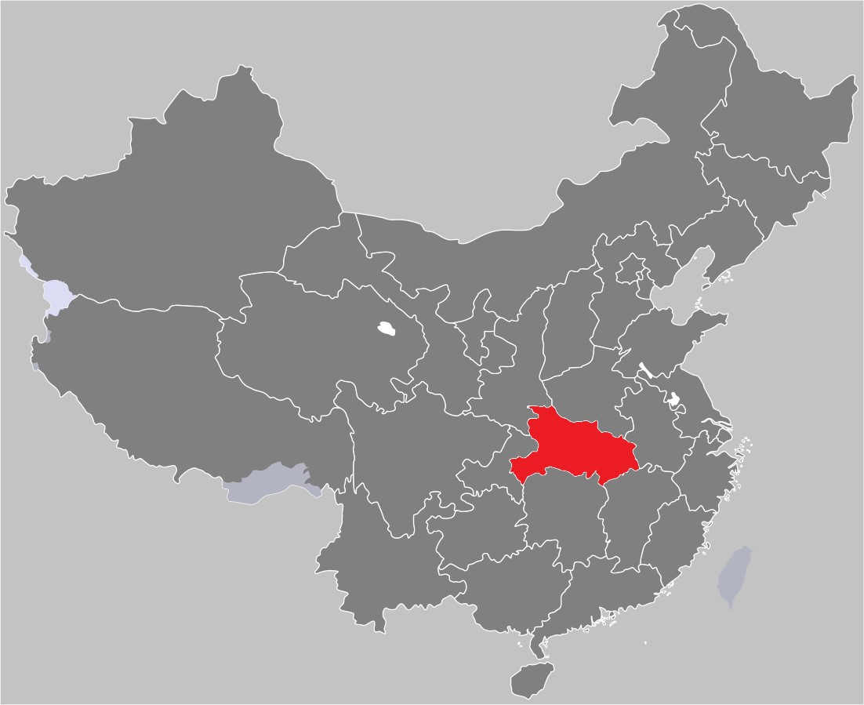
Who is impacted by quarantine?
Those who have been in mainland China in the past 14 days:
Health screening at designated airports & self-quarantine
Those who have been in Hubei Province in the past 14 days:
Mandatory quarantine
Notes:
The federal declaration had included a mandatory quarantine of travelers who had been to Hubei Province in China within the last 14 days. That period ends on February 6 because the government of China had restricted travel from the province on January 23, 2020.
Passengers returning to the United States who have been in the rest of mainland China will be allowed to continue on to their final destination if they do not have any symptoms of illness. They will undergo up to 14 days of self-quarantine to ensure they have not contracted the virus.
What is quarantine?
Quarantine is put into place to prevent the possible spread of an infectious disease from someone who may have been exposed to the disease but is not yet sick.
When people are quarantined, they are kept separate from others until they are out of the period when they could get sick.
During that time, health officials track their health so that if they do develop symptoms, they can get them to a healthcare provider quickly for evaluation, testing if needed, and care.
What is the difference between quarantine and isolation?
Quarantine is for people who are at increased risk for having been exposed to an infectious disease and could become sick and spread the infection to others, but who are not currently showing symptoms. Isolation is used for people who are currently ill and able to spread the disease and who need to stay away from others in order to avoid infecting them.
How does self-quarantine work?
When people are in self-quarantine, they have no symptoms, but because there is a possibility that they might have been exposed, they stay away from others in public settings.
For 14 days from their last possible exposure, people in self-quarantine cannot go to work, school, or any public places where they could have close contact with others.
Public health departments direct them in how to monitor their health so that should they develop symptoms, they can be quickly and safely isolated from all others, including those in their household.
We’ve found that people who are asked to self-quarantine want to do whatever they can to remain healthy, prevent others from becoming ill, and are very cooperative with our recommendations.
Can people in self-quarantine still have contact with their household members?
Yes, people in self-quarantine are not sick and can still have contact with their household members.
Should they develop any symptoms, they are asked to quickly and safely isolate from all others, including those in their household, and to contact their medical provider.
There’s still a lot to learn about novel coronavirus, but we know that typically people are thought to be most contagious with most respiratory viruses when they are most symptomatic (or feeling the sickest).

Slide 10
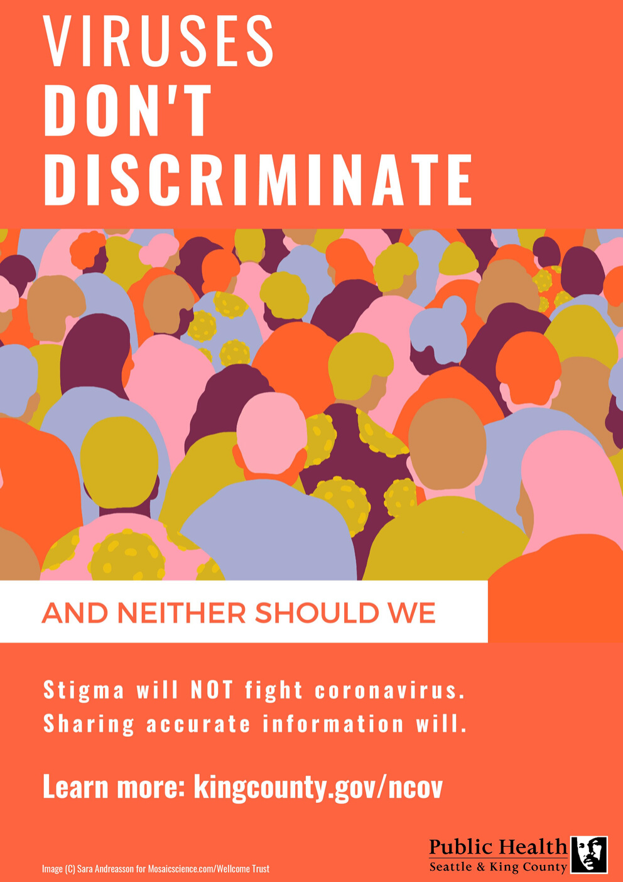
What can you do if you see stigma or bias?
Notes:
It’s very concerning that the people in our communities may be experiencing stigmatization or discrimination based on racial bias or appearances.
Please help others understand that the risk of coronavirus is not at all connected with race, ethnicity or nationality.
Sharing accurate information is one of the best things we can do to keep rumor and misinformation from spreading.
Website with resources for people who may be experiencing stigmatization or discrimination, including how to report incidents: https://kingcounty.gov/depts/health/communicable-diseases/disease-control/novel-coronavirus/anti-stigma
What to do if you see stigma and bias
Speak up if you hear, see, or read stigmatizing or harassing comments or misinformation.
Show compassion and support for individuals and communities most closely impacted and anyone who might be sick.
Rely on and share trusted sources of information about the causes of outbreaks from reputable sources like the Centers for Disease Control and Prevention and the Washington State Department of Health.
Website with resources for people who may be experiencing stigmatization or discrimination, including how to report incidents: https://kingcounty.gov/depts/health/communicable-diseases/disease-control/novel-coronavirus/anti-stigma
NOTE TO CALL TAKER: Some instances of discrimination may rise to the level of a hate crime and may need referral to law enforcement

Slide 11
What is Public Health doing?
Conducting disease surveillance & investigation
Coordinating services for cases under isolation and quarantine
Disseminating messages and materials
Engaging with communities who might be most impacted
Notes:
Public Health activated our Health and Medical Area Command to coordinate department-wide activities and help coordinate the many response activities internally and with external partners including identifying and managing surge staffing for the nCoV response in addition to the ongoing HAV outbreak.
A few of our key activities include:
Track and monitor the health of contacts of cases and persons who meet criteria for testing.
We are also working with our partners at the Department of Health and CDC to be responsive to the federal quarantine on certain passengers returning from Hubei Province and other parts of China, who will need to be quarantined for up to 14 days.
Providing and updating information for the public in multiple languages.
Providing information, health advisories and guidance to King County health care providers and hospitals regarding screening, identification, testing, and infection control measures to prevent transmission in the health care setting and the community (for persons meeting CDC criteria for investigation based on travel history, contact with a known case, and symptoms).
Working with leadership at multiple King County health care facilities and the Northwest Healthcare Response Network to ensure their readiness to evaluate and treat nCoV patients.
We expect more cases to be identified internationally and in the US, including possibly locally, before the outbreak ends.
It is not possible currently to predict the ultimate course or impact of this emerging outbreak. If transmission is high and the disease is severe, a global pandemic could result that would seriously challenge our healthcare, public health and emergency response systems, as well as our community resilience and our local and global economies.

Slide 12
What is the role of employers?
Review CDC's guidance for business and employers, which includes:
Actively encouraging sick employees to stay home
Separating sick employees
Emphasizing staying home when sick, respiratory etiquette and hand hygiene by all employees
Perform environmental cleaning
Advising employees before traveling to take certain steps
Start planning for pandemic flu
Notes:
Please update yourself with the Feb 2020 Interim Guidance for Employers, https://www.cdc.gov/coronavirus/2019-ncov/guidance-business-response.html
Start planning for pandemic flu, https://www.cdc.gov/coronavirus/2019-ncov/php/pandemic-preparedness-resources.html

Slide 13
QUESTIONS?
Ingrid Ulrey, Policy Director
Ingrid.ulrey@kingcounty.gov

