Slide 1

About RESULTS
Grassroots advocacy organization working to create the political will to end the worst aspects of poverty
Empowering individuals to exercise personal and political power
Over 35 years of advocacy experience
Time tested strategies and tactics
Active and engaged network building relationships with legislators, the media and local communities
Chapters in all 50 states and nearly a dozen countries

Slide 2
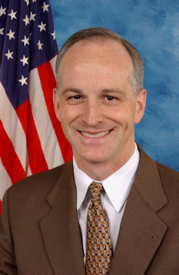
What is RESULTS?
“This is the best grassroots organization I work with. I get the question all the time, ‘What can we do to make what we care about happen politically?’ And the answer is so simple. I always cite RESULTS as the example. Go out across the country, get constituents from members of Congress’ district who care about your issues, and get them to lobby Congress. It’s that simple and that difficult. Nobody does it better than you.”
U.S. Representative Adam Smith (D-WA)

Slide 3


U.S. Poverty Campaigns
Defending Critical Nutrition & Health Programs
SNAP (formerly Food Stamps) and Medicaid, our most effective anti-poverty policies are facing unprecedented political threats. We must defend & strengthen these vital programs that serve our most vulnerable citizens.
Increasing Economic Mobility in the United States
We are pushing to increase economic mobility and promote racial equity. We advance policies that address inequality, help close the racial wealth gap, and create opportunity in the U.S. tax code.

Slide 4
Why Advocacy?
We stand by as children starve by the millions because we lack the will to eliminate hunger. Yet we have found the will to develop missiles capable of flying over the polar cap and landing within a few hundred feet of their target. This is not innovation. It is a profound distortion of humanity’s purpose on earth.
– former Sen. Mark Hatfield (R-OR)

Slide 5
Why Advocacy?
Advocacy is creating political will
  Telling decision-makers what our priorities should be
If we want something, we have to ask for it
  Every idea must have a voice
  Decision-makers are not all knowing
  At times, they need to be educated on the issue
Ultimately…it’s about change
  All major changes in social or economic policy, good or bad, happened because advocates did not give up
  Success requires keeping a long-term view. We can’t get bogged down by the occasional setback

Slide 6
What is Advocacy?
Who knows the name of your representative? Your senators? State/Federal?
Who has written a letter or email to them?
Who has called them?
Who has met with them?
Can we establish a good, working relationship with our elected officials?
Notes:
We live in a country where our government officials are elected to carry out the people’s business as our representatives.
So, who pays these people? Who do they work for?
If we pay their salaries and they work for us, who should supervising them?

Slide 7
The Power of RESULTS
Building Relationships with elected officials
RESULTS believes that we need to let our elected officials know what we care about, and what we want them to do.
Our goal is to move them up the Champion Scale by communicating regularly, providing good information, making specific requests, and mobilizing the media and community.

Slide 8
Assess where a person is on the Champion Scale, then move them up
What We Are Trying to Do
4 Champion
3 Leader
2 Advocate
1 Supporter
0 Uninformed or Neutral
-1 Opponent
Notes:
Any move we make on the Champion Scale is a win. If they move from Opponent to silence, there is less opposition. If we move them from a supporter to advocating with another member of Congress, it is a win.

Slide 9
How Decision Makers Decide
Constituents
Staff
Colleagues
Media
Paid Lobbyists
Experts
Personal History

Slide 10
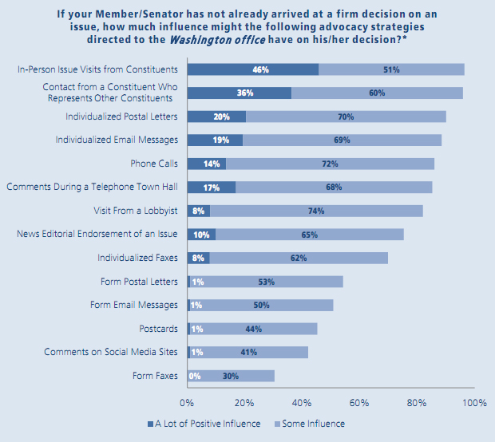
Good news about influence
Research by the Congressional Management Foundation shows that in-person meetings with constituents are the most effective way to influence lawmakers.
Source: Congressional Management Foundation

Slide 11
Good News About Influence
Constituent visits and individual letters are the most effective way to influence
Source: Congressional Management Foundation

Slide 12
RESULTS EPIC
Communication Tool
EPIC stands for:
Engage your audience
Problem Statement
Inform about the solution and
Call to action.

Slide 13
RESULTS EPIC
Communication Tool
.
  E = Engage Your Audience
  Get your listener’s attention with a dramatic fact or short statement.
  Keep your opening statement to one sentence if possible. Be powerfully succinct.

Slide 14
RESULTS EPIC
Communication Tool
  P = State the Problem
  Present causes of the problem you introduced in the engage section.
  How widespread or serious is the problem?

Slide 15
RESULTS EPIC
Communication Tool
I = Informing about Solutions
Inform your listener about a solution to the problem.
Develop your solution by examples of how and where it has worked.
You could site a recent study or report or tell a first-person account of how the solution has impacted you or others you know.

Slide 16
RESULTS EPIC
Communication Tool
C = Call to Action
Now that you’ve engaged your listener, presented the problem and informed them of a solution, what do you want them to do?
Make the action something specific so that you will be able to follow up with them and find out whether or not they have taken the action.
Present the action as a yes or no question.
Offer to provide additional background information.

Slide 17
Letter Writing and Laser Talk Tips
Use EPIC format
Thank the elected official for previous actions
Use personal experience to illustrate the point
Make a specific ask
Request a response
Fax your letter or submit electronically
Include full name, address and email
Follow up with an email or call

Slide 18
Raise Your Voice!
Never doubt that a small group of thoughtful, committed citizens can change the world. Indeed, it is the only thing that ever has.
— anthropologist Margaret Mead

Slide 19
Research your elected officials
RESULTS Action Center
www.results.org
Under “Join Us” select “Take Action Today”
U.S. House of Representatives
www.house.gov/representatives
U.S. Senate
www.senate.gov/senators
Washington State Legislators
app.leg.wa.gov/DistrictFinder/

Slide 20
Resources
Activist Action Center — Developing the Skills to Become a Trained Citizen Advocate
https://results.org/volunteers/advocacy-basics/
Reclaiming Our Democracy: Healing the break between people and government
By Sam Daley-Harris, Founder of RESULTS
Soul of a Citizen: Living with Convection in Challenging Times, by Paul Loeb

Slide 21
Let’s Act Together
Melessa Rogers
melessa@glaserprogress.org
www.results.org
Facebook “RESULTS Seattle”

